Slide 1
CSE322 Finite Automata
Lecture #2

Slide 2

UNIT I FINITE AUTOMATA

Slide 3
UNIT-I SYLLABUS
FINITE AUTOMATA : The Equivalence of Deterministic and Non-deterministic Finite Automata, Definition and Description of a Finite Automaton, Deterministic and Non-deterministic Finite State Machines, Acceptability of a String by a Finite Automaton, Mealy and Moore Machines, Minimization of Finite Automata, Basics of Strings and Alphabets, Transition Graph and Properties of Transition Functions, Regular Languages.

Slide 4
Finite Automaton
Input
String
Output
“Accept”
or
“Reject”
Finite
Automaton

Slide 5
Finite Automata
Finite automata are used to recognize patterns.
It takes the string of symbol as input and changes its state accordingly. When the desired symbol is found, then the transition occurs.
At the time of transition, the automata can either move to the next state or stay in the same state.
Finite automata have two states, Accept state or Reject state. When the input string is processed successfully, and the automata reached its final state, then it will accept.

Slide 6
Theory of Automata
Theory of automata is the study of abstract machines and the computation problems that can be solved using these machines.
The abstract machine is called the automata.

Slide 7
The automaton consists of states and transitions. The State is represented by circles, and the Transitions is represented by arrows.
Automata is the kind of machine which takes some string as input and this input goes through a finite number of states and may enter in the final state.

Slide 8
Terminologies used in Automata
Symbols:
Symbols are an entity or individual objects, which can be any letter, alphabet or any picture.
Example:
1, a, b, #

Slide 9
Alphabets:
Alphabets are a finite set of symbols. It is denoted by ∑.
Examples:
∑ = {a, b}
∑ = {A, B, C, D}
∑ = {0, 1, 2}
∑ = {0, 1, ....., 5}
∑ = {#, β, Δ}

Slide 10
String:
It is a finite collection of symbols from the alphabet. The string is denoted by w.
Example 1:
If ∑ = {a, b}, various string that can be generated from ∑ are {ab, aa, aaa, bb, bbb, ba, aba.....}.
A string with zero occurrences of symbols is known as an empty string. It is represented by ε.
The number of symbols in a string w is called the length of a string. It is denoted by |w|.
Example 2:
w = 010
Length of String |w| = 3

Slide 11
Language:
A language is a collection of appropriate string. A language which is formed over Σ can be Finite or Infinite.
Example: 1
L1 = {Set of string of length 2} = {aa, bb, ba, bb} Finite Language
Example: 2
L2 = {Set of all strings starts with 'a'} = {a, aa, aaa, abb, abbb, ababb} Infinite Language

Slide 12
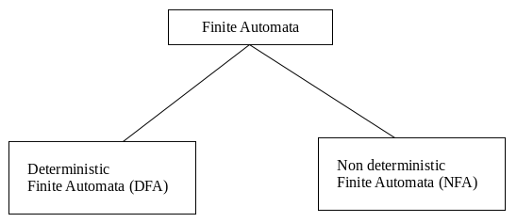
Types of Automata
There are two types of finite automata:
1. DFA(deterministic finite automata)
2. NFA(non-deterministic finite automata)

Slide 13
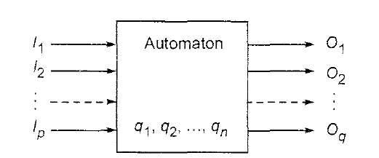
Automaton:
An automaton is defined as a system where
- energy, materials and information are
- transformed, transmitted and used
- for performing some functions without direct participation of man.

Slide 14
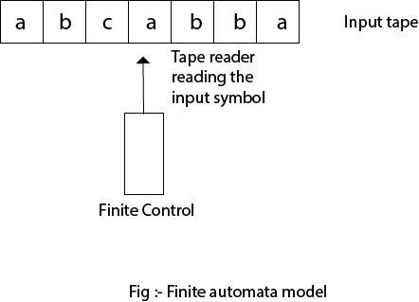
Finite Automata Model:
Finite automata can be represented by input tape and finite control.

Slide 15
Input tape: It is a linear tape having some number of cells. Each input symbol is placed in each cell.
Finite control: The finite control decides the next state on receiving particular input from input tape. The tape reader reads the cells one by one from left to right, and at a time only one input symbol is read.

Slide 16
Formal Definition of Finite Automaton
where
: Finite non-empty set of states
: Finite non empty set of input alphabets
: (direct) transition function that maps Q x ∑ -> Q
: initial state
: set of final states

Slide 17

There are numerous applications of Formal languages and Automata Theory like:
Text processing, Compilers and Hardware Design
Motors and Vending machines
Sensors and Transducers
Automata Simulators
And many more ….

Slide 18
Transition Diagram
A transition diagram or state transition diagram is a directed graph which can be constructed as follows:
There is a node for each state in Q, which is represented by the circle.
There is a directed edge from node q to node p labeled a if δ(q, a) = p.
In the start state, there is an arrow with no source.
Accepting states or final states are indicating by a double circle.

Slide 19
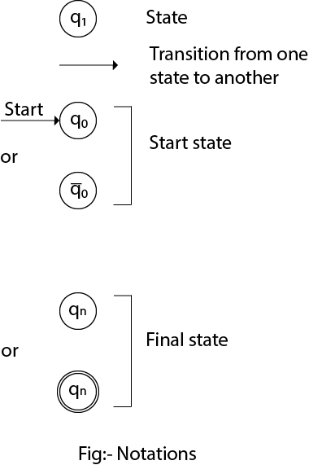
Notations used in the transition diagram

Slide 20
Transition Graph
initial
state
final/accepting
state
transition
state

Slide 21
Initial Configuration
Input String

Slide 22
Reading the Input

Slide 26
Input finished
accept

Slide 27
Rejection

Slide 31
Input finished
reject

Slide 32
Another Rejection

Slide 33
reject

Slide 34
Another Example

Slide 38
Input finished
accept

Slide 39
Rejection Example

Slide 43
Input finished
reject

Slide 44
Languages Accepted by FAs
FA
Definition:
The language contains
all input strings accepted by
= { strings that bring
to an accepting state}

Slide 45
accept

Slide 46
Example
accept
accept
accept

Slide 47
Example
accept
trap state

Slide 48
Transition Function

Slide 52
Transition Function

Slide 53
Extended Transition Function

Slide 57
Recursive Definition

Slide 58
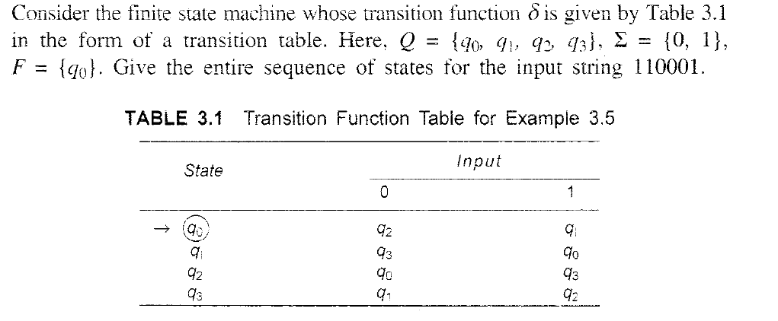

Slide 59
